Slide 1
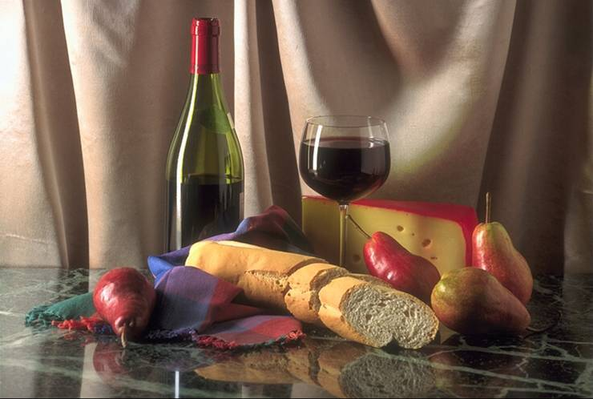
Module 3
Foreign food

Slide 2
Introduction Page 29
Qs:
Can we go without food?
Can you name some Chinese food as well as some foreign food?

Slide 3
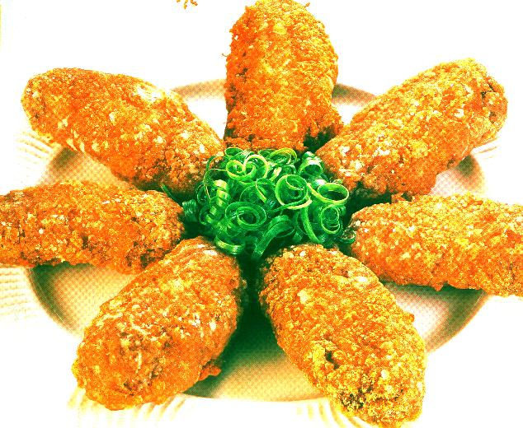
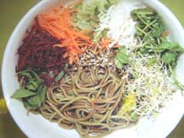
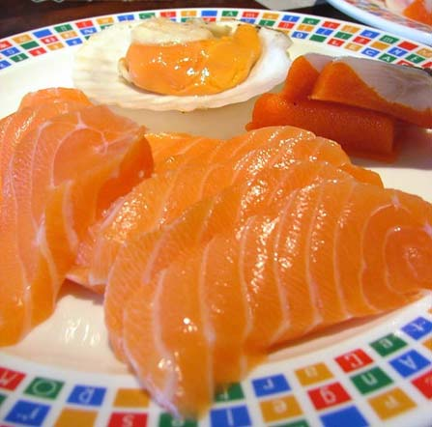
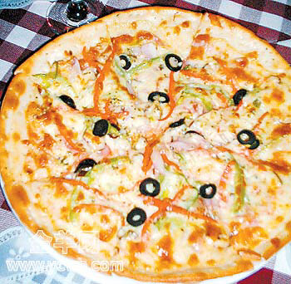
Fried chicken
salad
raw fish
pizza

Slide 4
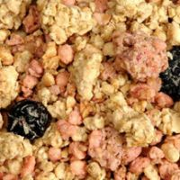
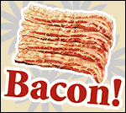
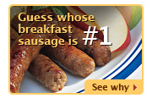
British food
cereal
bacon
sausage

Slide 5
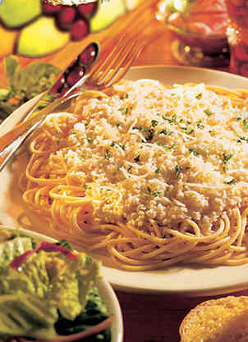
Italian food
Spaghetti

Slide 6
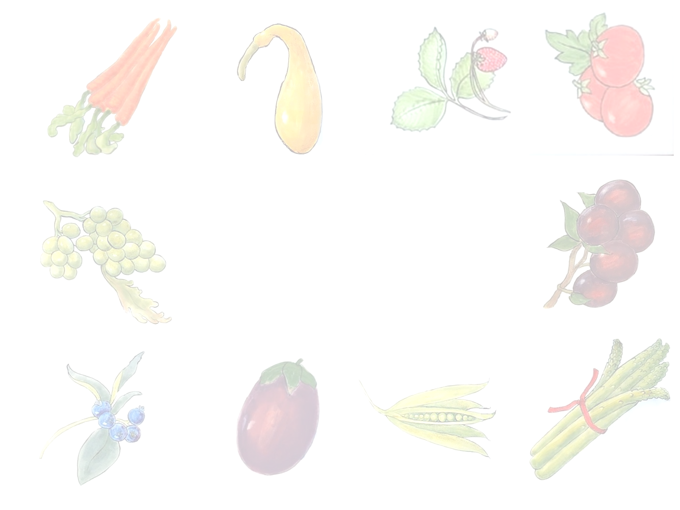

Everything you see I owe to spaghetti.
She likes eating spaghetti and it is spaghetti that helps build her good figure.
Eat little , sleep well.
吃少睡好
What is food to one man may be poison to another .
一个人的食物可能为另一个人的毒药。

Slide 7
Cookery is not chemistry. It is an art.
烹饪不是简单的物质组合，他是一门艺术。
If you’re going to America, bring your own food.
你要去美国的话要带上自己的食物
You should eat to live, not live to eat.
吃饭是为了生存，但生存不是为了吃饭。

Slide 8
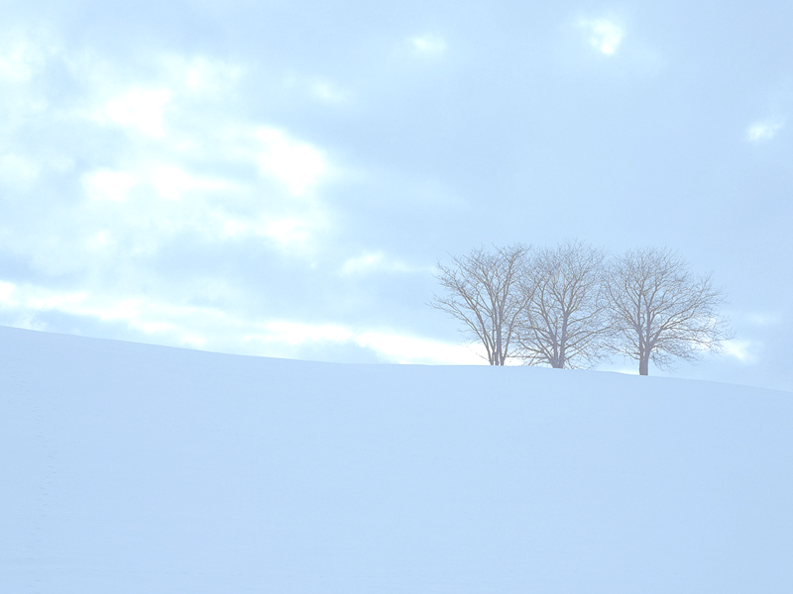

What do you think :
1.an American eating food in China will notice
2.a Chinese person will notice when eating British food for the first time
The quantity of the food
What people do while they are eating
The taste of the food
The temperature of the food
The strange things people eat

Slide 9
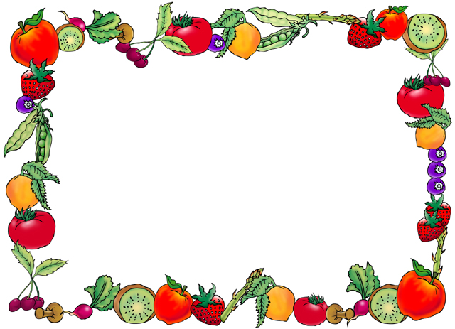
Now listen to the tape and do the following exercises.

Slide 10
Passage One

Slide 11
Choose the right answers.
Passage One
1.It seems that the writer______.
A.had good opinions of Chinese food.
B.thought little of Chinese food.
C.thought badly of Chinese food.
D. thought Chinese people wasted a lot of food.
A

Slide 12
2.Which of the following is not related to the writer’s attitude?
A. Chinese people are sometimes obsessed with food.
B. I could not imagine how fabulous a real Chinese banquet could be.
C. These days I enjoy that sort of food myself.
D. I was already so full that I could only watch as the banquet continued.
D

Slide 13
3. By telling about his experience at the banquet, the writer wanted to ______.
A. tell people that Chinese people pay great attention to food.
B. say he was not experienced at a Chinese banquet.
C. tell people too much food was served at a Chinese banquet.
D. tell people to eat little first at a Chinese banquet
A

Slide 14
4. By saying “Another aspect of ‘food culture’ is that the Chinese seem to eat almost every part of every animal---much to the horror of many westerners.”, the writer ________.
A. wants to give information about Chinese food culture
B. wants t osay Chinese food culture is horrible to westerners
C. shows Chinese food culture is fabulous
D. shows every nation has its own food culture
A

Slide 15
Passage Two
1. From the passage ,we mainly learn______.
A. about her experiences in England
B. some of the differences between Chinese food and English food
C. English people have good table manners
D. English food
B

Slide 16
2. What does the writer think of English food and Chinese food?
A. Chinese food is prepared with more care at the appearance.
B. English food is prepared very carelessly
C. Cold food is liked by English people.
D. Mixed food is served at the table.
A

Slide 17
3. The writer ______ the mushroom soup to be mixed with other things.
A. could not get used to B. felt it hard to know
C. didn’t expect D. thought it funny for
4. The purpose of the writer is _____.
A. to tell about English food culture.
B. to show her positive attitude towards English food.
C. to show her negative attitude towards English food.
D. to tell what she thinks about English food
C
A

Slide 18
Passage 1
What mistake did the writer make at the Chinese banquet?
What surprised the writer at the banquet?
3. What did the writer find shocking at first but then got use to eating ?
He thought the food first served was the total number of the dishes to be served and started eating greedily .
More dishes arrived ,plus soups,side dishes,and desserts.
Almost every part of every animals ,such as stomach, intestines, ears, tongue,tail ,hoof and lungs.
◄

Slide 19
Passage2
What does the writer say about the appearance of food?
2. What does the writer think about eating cold food?
3. What does the writer think about the way British people eat?
At the counter there were colorful mixtures in eight or nine big boxes and it was quiet hard to make out what they contained.
He think cold food means poverty and should not be given to a guests.
One thing he does admire is the polite manner in which British people eat,even if it is just a potato.

Slide 20
Passage One
Part 1
That Chinese are obsessed with food is part of Chinese food culture, which is concluded by a foreigner after his experience eating at a banquet in Beijing.
Part 2
Chinese’s food includes a variety of animals’ parts, which the foreigner found hard to accept at the beginning, but later, became fond of.
Para.1-2
Para.3-5

Slide 21
Passage Two
Para.1
The writer likes the British people’s table manners but not their cold food.
Para.2
The absence of beauty and style of food makes the food look not so tasty as it should be.
Para.3
The names of the English food are hard to remember.

Slide 22
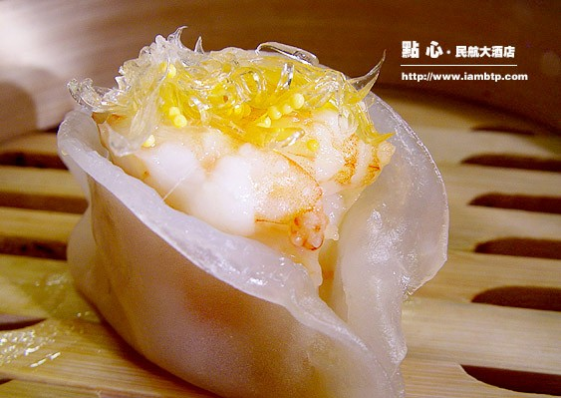
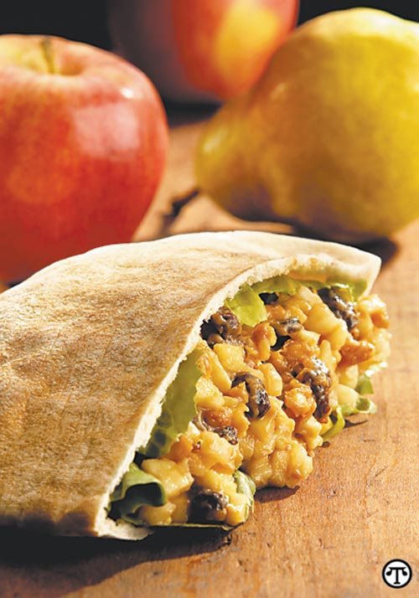
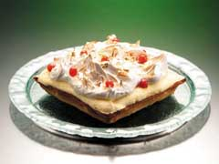
What is the difference between Chinese food and foreign food?
Chinese food
many kinds of food
They can eat whatever they get
Sense of beauty.
foreign food
cold food
Choose whatever they want
They mash food into an unrecognisable shape.

Slide 23
Fill in the blanks with the expressions given.

Slide 24
1. (1) A person who rules a certain place is a___. A ___ may be a ruler. A ____ is not necessarily a king.
(2) George Bush is a ___,but he is not a___.
A. king B. ruler
1 (1) He ___ at the party yesterday.
(2) The difference of ____friends to dinner between the two cultures are amazing.
A. entertaining B. had a good time
B
A
B
B
A
B
A

Slide 25
3. (1) Young leaves of trees are ___.As they grow, they get___.
(2) The meat which is not cooked enough is ___ and hard to eat.
A. tender B. tough
4. (1) He lost so many marks in the exam ___because he was not careful enough.
(2) It is not a very formal occasion, so you can dress _____.
A. casually B. simply
A
B
B
B
A

Slide 26
5
(1) He didn’t know table manners, so he just followed the host to avoid________.
(2) ______between people may cause quarrels.
A. embarrassment
B. misunderstanding
A
B

Slide 27
consume vt. 1.消费,花费 2.毁灭,耗尽
她把大部分时间都花在读书上。
She consumed most of her time in reading.
他们一会儿功夫便把桌上的食品全部吃光。
They soon consumed all the food on the table.
一场大火把这个小镇化为灰烬。
A great fire consumed the town.
那男孩充满好奇心。
The boy was consumed with curiosity.

Slide 28
* outnumber vt.
=be more in number than (sb)在数量上超过(某人)
我们的人数只及敌人的一半.
We were outnumbered two to one by the enemy.
*The consequence is that…后果是…
后果是她损失了所有的财产。
The consequence is that she lost everything she owned.

Slide 29
根据句意,用for example,such as,like或namely填空。
1.Noise，_________ ，is a kind of pollution.
2.I like drinks _________________tea and soda.
3.___________ ，my full name is James Allen Green. Green is my family name.
4.Only one person can answer the question _________ you.
5.You can buy fruit here—oranges and bananas，_________ .
6. We don't enjoy _____ a book _____ that.
7.This novel is translated into three foreign languages, ________,English, German and French.
for example
like/ such as
For example
namely
for example
such as
namely

Slide 30
Cultural Corner
The Willow Pattern Plate

Slide 31
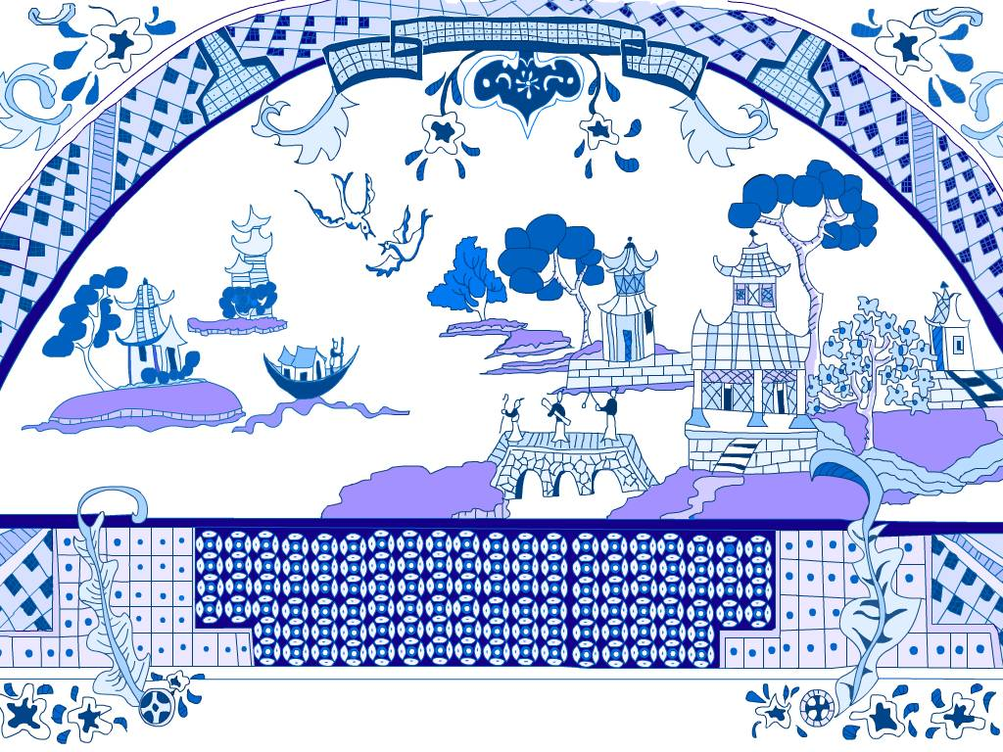
What is the willow pattern like?

Slide 32
Fast reading:
Answer to the questions on Page 41:
1 The willow pattern plate shows a romantic scene based on an old Chinese story about the daughter of a rich Mandarin. She was in love with a gardener. Her father was very angry and tried to stop them from being together but they ran away. They were killed in a fire started by the girl’s father but their souls became songbirds which we can see in the picture of the willow pattern design.
2 open

Slide 33
Careful reading: Make the best choices:
C
The passage is mainly about _______.
A. willow tree B. a love story
C. a pattern plate D. two songbirds
2. The Mandarin tried to stop his daughter from marrying the young man, perhaps because ______.
A. the young man was too poor
B. the Mandarin looked down upon him
C. the status of the young man was low
D. all the above
D

Slide 34
3.Which of the following statements is false?
A. The willow pattern plates are kept for special occasions.
B. The first plates of this kind were made in about the seventeenth century.
C. No original Chinese designs included all the designs together.
D. At last the daughter of the Mandarin and the young man were burnt to death.
B

Slide 35
Grammar

Slide 36
定语
一、概念:
定语是用来修饰名词或代词的成分。
二、位置：
前置定语：位于中心词前。(单个词或者复合词)
后置定语：位于中心词之后。(词组或从句)
另:修饰something, anything, nothing的单个形容词定语时，也要后置。
如：There is something wrong with my watch.

Slide 37
Q: What is the difference between the following pair of phrases:
the present members
the members present
the responsible man
the man responsible
现在的
出席的
可信赖的；
应负责任的

Slide 38
【高考衔接】
D
(NMET 1993)He dropped the ____ and broke it .
A. cup of coffee B. cup for coffee
C. coffee’s cup D. coffee cup
2. (NMET 2001 )The _____ is just around the corner and you won’t miss it .
A. bicycle’s shop B. bicycle shop
C. bicycles shop D. bicycle’s shop
B

Slide 39
名词修饰名词
作定语的名词往往是说明其中名词的材料、用途、时间、地点、内容、类别等。
如:a diamond necklace; a stone bridge; a meeting room; welcome speech; evening suit; body temperature; the kitchen window; a story book; piano lessons;the sports meet; children education等。
对比：
a student teacher
实习教师
a student’s teacher
一位学生的老师
表类别
表所属

Slide 40
3. (1999 上海) There are five pairs of shoes ______ , but I'm at a loss which to buy .
A. to be chosen B. to choose from
C. to choose D. for choosing
4. (NMET1997)--- How was your recent visit to Qingdao ?
--- It was great . We visited some friend , and spent the _____ days at the seaside.
A. few last sunny B. last few sunny
C. last sunny few D. few sunny last
B
B

Slide 41
5. (NMET 1998)If I had ______ , I’d visit Europe , stopping at all the small interesting places .
A. a long enough holiday
B. an enough long holiday
C. a holiday enough long
D. a long holiday enough
6. (NMET2000)_____ to take this adventure course will certainly learn a lot of useful skills .
A. Brave enough students
B. Enough brave students
C. Students brave enough
D. Students enough brave
A
C

Slide 42
三、词序：
his father’s expensive new green silk socks
her first beautiful little British oil painting
限定词+ 性质(描绘/观点)+ 大小、长短、高低(矮) + 形状+ 年龄、新旧+ 颜色+ 国籍、地区、出处+ 物质、材料+ 用途、类别+ 动名词、名词中心词.
县官行令杀国才

Slide 43
一个小而圆的、老式的、中式木质棕色书桌，很吸引人
a charming small round old brown Chinese wooden writing table
县官行令杀国才

Slide 44
Read the sentences,and give the correct form of the verb in the brackets.
1) Do you know the astronauts __________ (carry)out scientific experiments in space now?
2) People __________(work) in the field of science are called scientists.
3) The question_____________(discuss) next is about how to get rid of environmental pollution.
4) Th advertisement_______(make)by this advertising firm last month is misleading, because it hid important information.
5) Flowers ________in this way look more beautiful.
6) Look out! There is snow______(fall) on the _____(fall) leaves on the ground.
carrying
working
to be discussed
made
growing
falling
fallen

Slide 45
Complete the following sentences.
1) The first thing _______we must do is to mend those shoes.
2) This is the most interesting story _______he’s ever heard.
3) The doctor did all ______they could to save the dying patient.
4) They talked about things and persons________ they were interested in.
5) Who is the person ________ waved his hand to you when we were taking a walk in the avenue.?
that
that
that
that
that

Slide 46
6) He took out a pistol with _________ he shot at the murderer.
7) Dinner starts with a small dish, __________ is often called a starter.
8) October 1st,1949 is the day ______ New China was founded.
9) October 1st,1949 is the day___________ is very special to him because it is the day ________ he was born.
10) We paid a visit to the village_________Lu Xun was born.
which
which
when
that/which
when
where

Slide 47
11) It is now a very famous village ___________ thousands of people visit every day.
12) Can you tell me the reason _____he was late?
13) The reason _____ he told for being absent from the meeting was not believed by the president.
14) People study the computer for the simple reason ______ they can get a well-paid job in future.
15) Last month we went to a chemical work,_____ was set up in the 1960’s and ______ my father has worked for dozens of years.
which
why
that
that
which
which

Slide 48
16) Please show me the coat ______________ you bought from that department store.
17) He is wearing the same coat ___________you bought from that department store.
18) Don’t read books ____________are harmful to your mind.
19) Such experience __________I have is useless in this situation.
20) ______ we all know, history is created by the working people.
which/that
as/that
which/that
as
As

Slide 49
Thank You

